Slide 1



Verifying your indicators in the Data Visualizer app
DHIS2 Customization

Slide 2


Indicators
How can we check that they work correctly?
Notes:
Once we have created our indicators in DHIS2, how can we check that they work correctly?

Slide 3
In this video, you will see…
Indicators
How to confirm that the indicators are calculated correctly
Notes:
In this video, we will confirm that the indicators created in this course are calculated correctly using the Data Visualizer app. This is the final step to ensure your indicators are properly functioning.

Slide 4
Notes:
DEMO

Slide 5
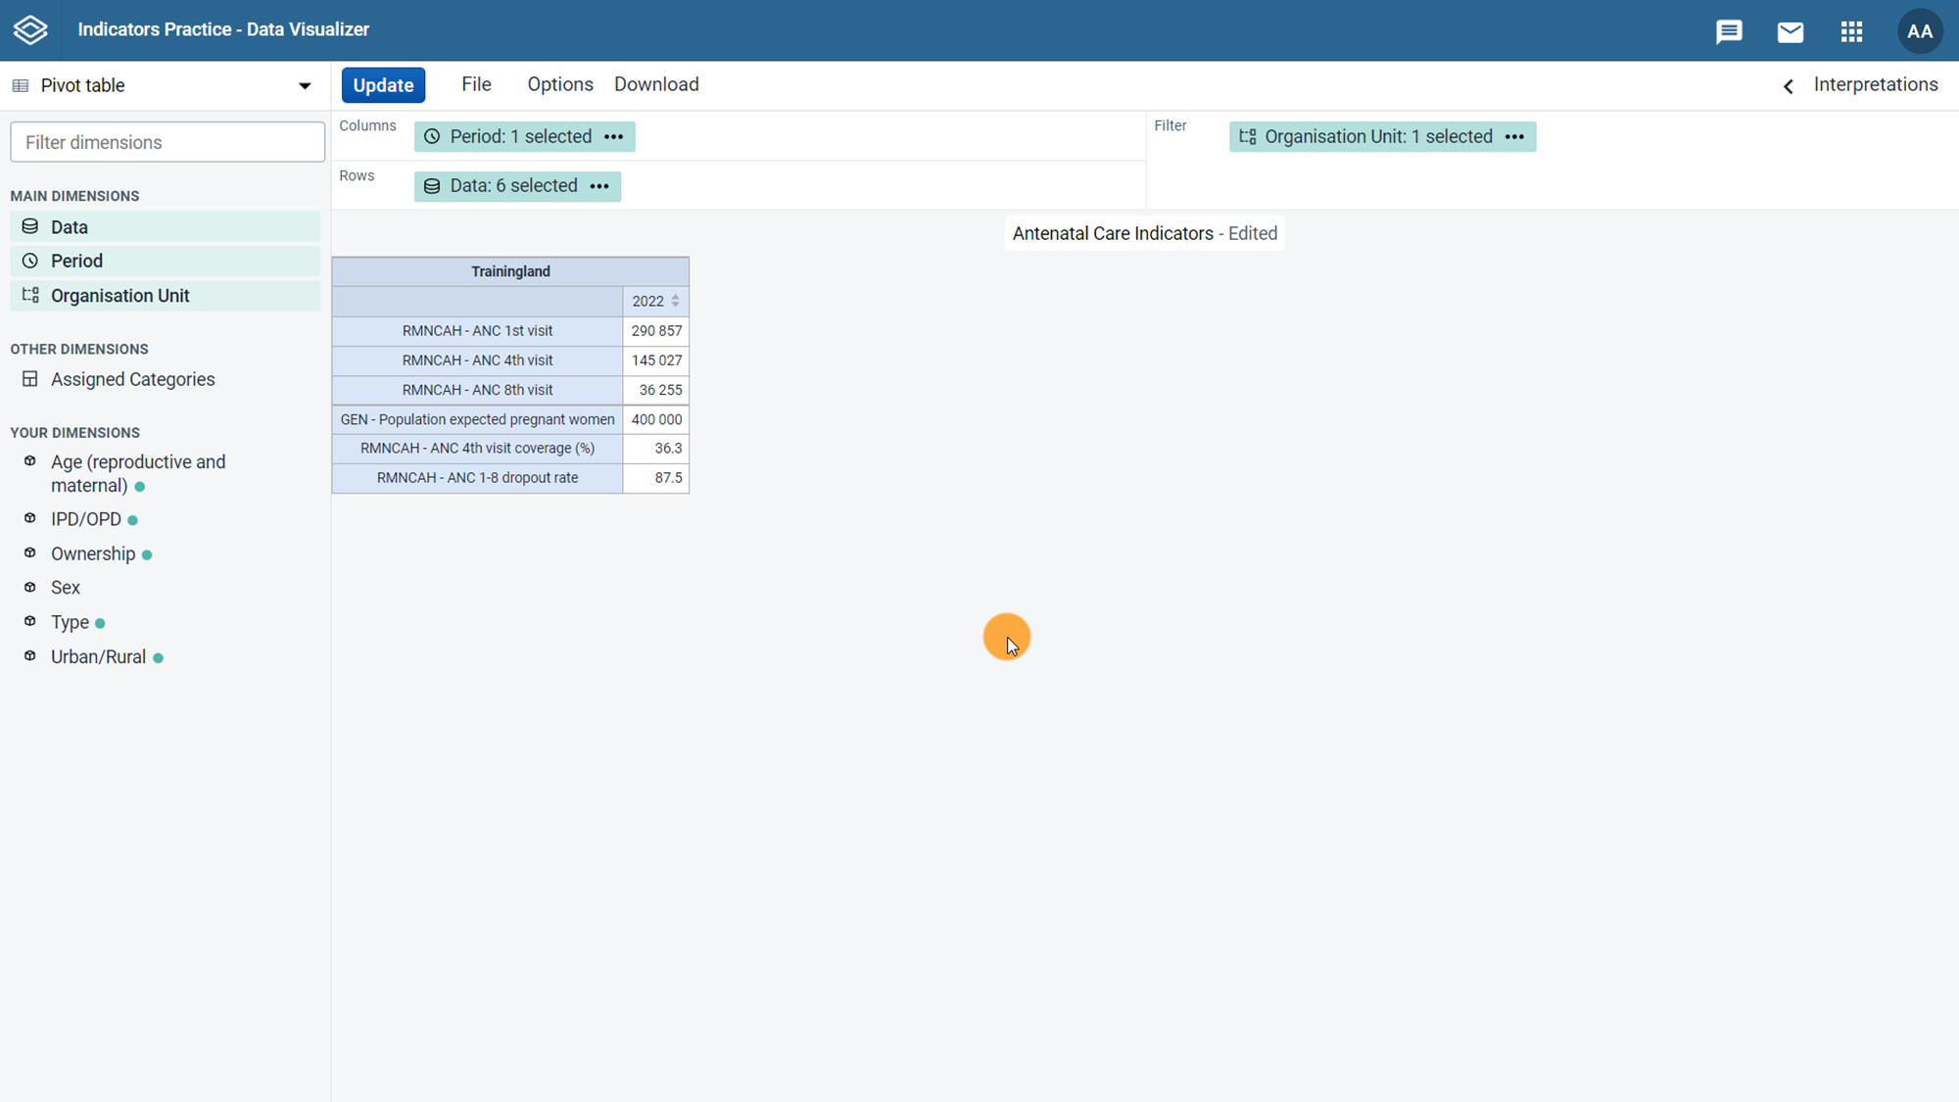



Perform the calculation yourself
145 027
ANC 4th visit coverage (%)
=
X
100
=
36.3
400 000
Notes:
In the table, confirm the indicators are calculated correctly by using the values in the table that make up the indicator calculation and performing the calculation yourself.
First, let's check the ANC 4th visit coverage indicator. The calculation is ANC 4th visit divided by population of expected pregnant women multiplied by 100.
We can see that our calculated value is the value of the ANC 4th visit coverage indicator in the table.

Slide 6
290 857
-
36 255
ANC 1-8 dropout rate
=
X
100
=
87.5
290 857
Notes:
Now, let's check the ANC one through eight dropout rate indicator.
The calculation is ANC 1st visit minus ANC 8th visit, divided by ANC 1st visit multiplied by 100.
The calculated value is the value of the ANC one through eight dropout rate indicator in the table.

Slide 7
How to use the Data Visualizer app:
DHIS2 Data Analysis
Notes:
You can learn more about how to use the Data Visualizer for this and other purposes in the fundamentals course, DHIS2 Data Analysis.

Slide 8
Summary
If your DHIS2 instance has data
Verify indicators
Use the Data Visualizer app:
Compare the outputs with the data values for your numerators and denominators
Notes:
To summarize, if your DHIS2 instance has data in it for the data elements that make up the indicators you have created, it is best practice to confirm that the calculations in your indicators are correct by using the Data Visualizer application to compare the output from your indicators with the corresponding data values for your numerators and denominators.

